Slide 1
Educational Organisation Using ServiceNow

Slide 2
Introduction to Educational Organizations and ServiceNow
Educational organizations utilize various tools to streamline operations and improve student experiences.
ServiceNow is a leading platform that offers comprehensive IT service management solutions.
Implementing ServiceNow can significantly enhance the efficiency and effectiveness of educational institutions.
Notes:
Image source: https://n2.help

Slide 3
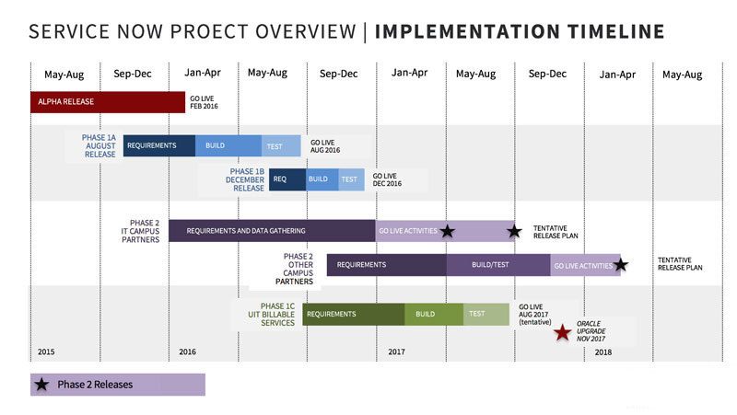
Overview of ServiceNow Platform
ServiceNow provides a cloud-based platform that automates IT and business workflows.
It supports a wide range of applications including incident management, asset management, and HR services.
The platform is highly customizable to meet the unique needs of educational organizations.
Notes:
Image source: https://uit.stanford.edu

Slide 4
Benefits of Using ServiceNow in Education
ServiceNow improves communication and collaboration across departments within educational institutions.
It enables faster resolution of technical issues and service requests from students and staff.
The platform promotes data-driven decision-making through comprehensive analytics and reporting.
Notes:
Image source: https://www.slidemake.com

Slide 5
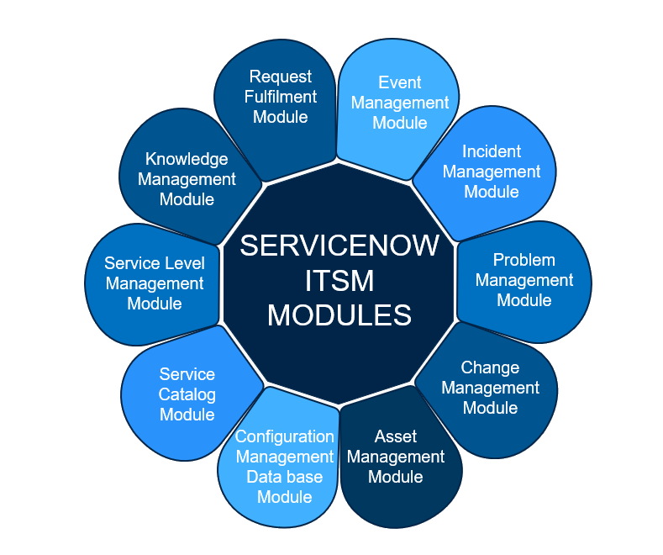
Key Modules for Educational Organizations
IT Service Management (ITSM) helps manage IT support and infrastructure effectively.
HR Service Delivery streamlines onboarding, offboarding, and HR requests.
Facilities Management assists in maintaining campus infrastructure and resources.
Notes:
Image source: https://cdn.shopify.com

Slide 6
Implementing ServiceNow in Educational Settings
Successful implementation begins with a thorough needs assessment and stakeholder engagement.
Custom workflows can be designed to align with institutional policies and processes.
Training and change management are critical for user adoption and long-term success.
Notes:
Image source: https://www.slidemake.com

Slide 7
Use Cases in Education
Automating student support services such as enrollment, financial aid, and counseling.
Managing campus facilities, maintenance requests, and asset inventories.
Supporting faculty and staff with IT requests and administrative processes.
Notes:
Image source: https://www.slidemake.com

Slide 8

Challenges and Considerations
Data privacy and security are paramount when handling sensitive student and staff information.
Resistance to change can slow adoption; effective communication is essential.
Budget constraints may impact the scope and scale of ServiceNow deployment.
Notes:
Image source: https://www.teacherph.com

Slide 9
Best Practices for Deployment
Start with pilot programs to test workflows and gather feedback.
Involve end-users in the design process to ensure the platform meets their needs.
Continuously monitor performance and update configurations to optimize service delivery.
Notes:
Image source: https://nowcompiler.com

Slide 10
Future Trends in Educational Technology with ServiceNow
Integration of AI and machine learning to automate routine tasks and improve predictive analytics.
Increased use of mobile apps and portals for easier access to services by students and staff.
Expansion of self-service options to empower users and reduce administrative workload.
Notes:
Image source: https://www.researchgate.net

Slide 11
Conclusion and Summary
ServiceNow offers valuable solutions to modernize and streamline educational organization operations.
Successful deployment depends on strategic planning, user engagement, and ongoing evaluation.
Embracing ServiceNow can lead to improved service quality, operational efficiency, and student satisfaction.
Notes:
Image source: https://event.on24.com

Slide 12
References
ServiceNow Official Website. (2023). Education Solutions. https://www.servicenow.com/industries/education.html
Gartner Research. (2022). The Future of IT Service Management in Education.
EdTech Magazine. (2023). How ServiceNow Is Transforming Campus Operations.

